Slide 1
Web Scraping
Python, PhantomJS, & Selenium

Slide 2
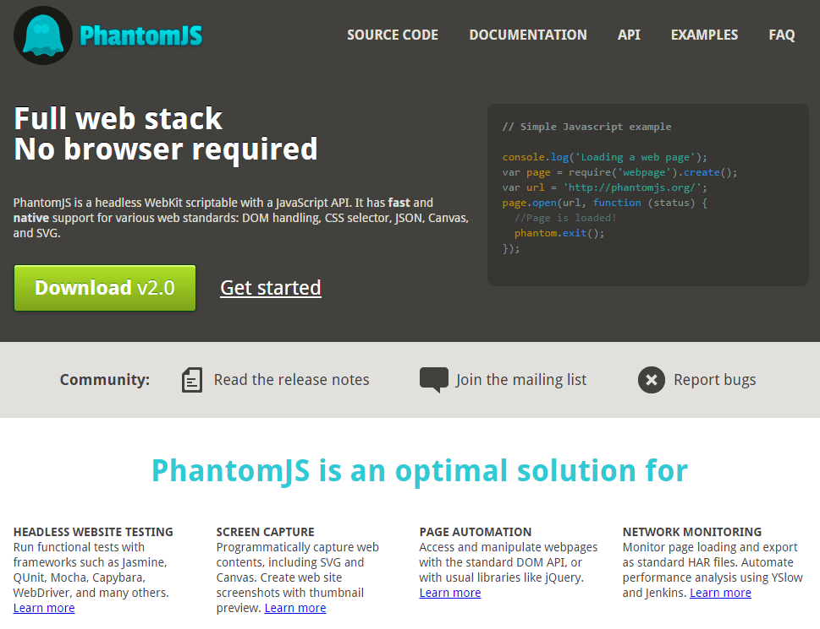

Slide 3
Why PhantomJS?
Headless WebKit Browser
Runs JavaScript
Inject JavaScript
Interact with the page (forms, etc)
Take screenshots

Slide 4
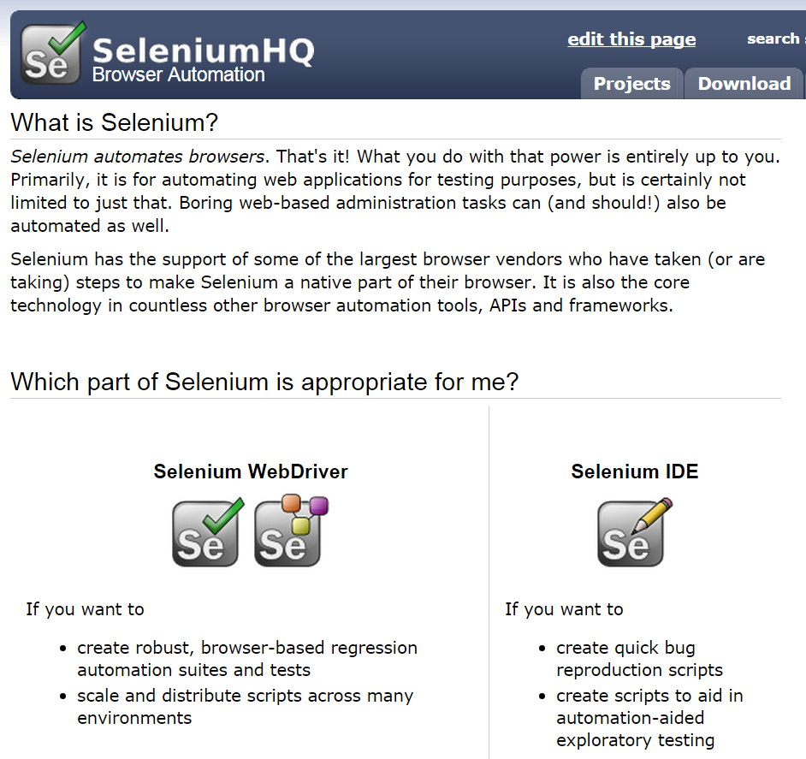
Selenium automates browsers
http://docs.seleniumhq.org/

Slide 5
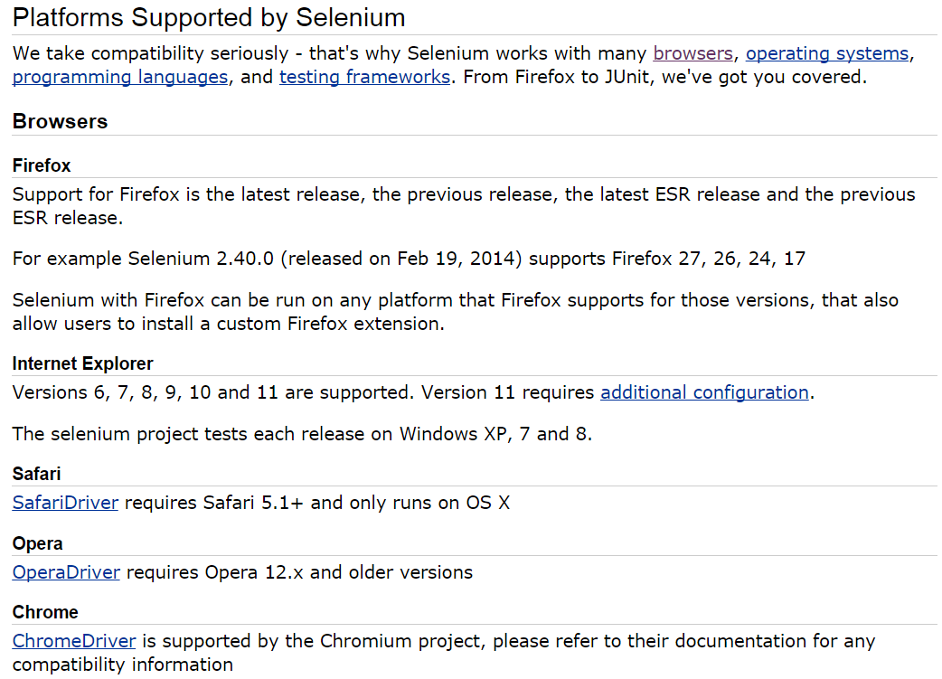

Slide 6
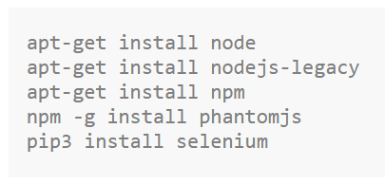
Install...
https://simpletutorials.com/c/2191/Installing+Selenium+and+PhantomJS+for+Python+3+on+Ubuntu+14.04

Slide 7
robots.txt

Slide 8
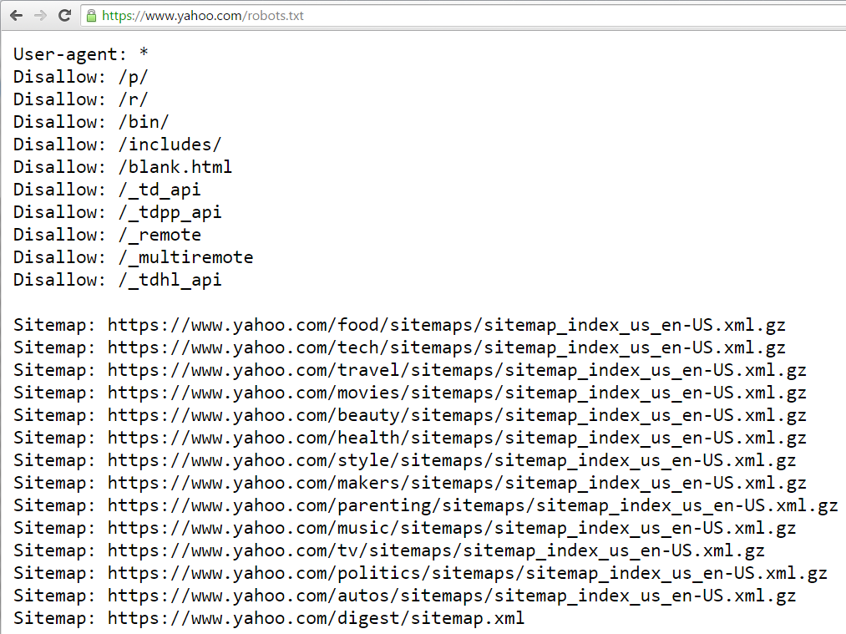

Slide 9
Robots.txt Parser
https://docs.python.org/3/library/urllib.robotparser.html

Slide 10
Docs
https://selenium-python.readthedocs.org/
http://selenium-python.readthedocs.org/en/latest/api.html

Slide 11
User Agent
... { "headers": { "Connection": "close", "Host": "httpbin.org", "Accept-Encoding": "gzip", "Accept-Language": "ru-RU", "User-Agent": "Mozilla/5.0 (Unknown; Linux i686) AppleWebKit/534.34 (KHTML, like Gecko) PhantomJS/1.10.0 (development) Safari/534.34", "Accept": "text/html,application/xhtml+xml,application/xml;q=0.9,*/*;q=0.8" } ...
http://stackoverflow.com/questions/17858663/custom-headers-in-phantomjs-selenium-webdriver

Slide 12
User Agent
DesiredCapabilities.PHANTOMJS['phantomjs.page.settings.userAgent'] = \
'Mozilla/5.0 (Windows NT 6.1; Win64; x64; rv:16.0) Gecko/20121026 Firefox/16.0'
http://stackoverflow.com/questions/28532347/selenium-with-phantomjs-yahoo-login-form-not-submitting-python-bindings?rq=1

